Slide 1
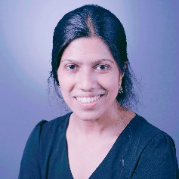

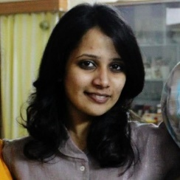


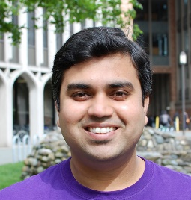
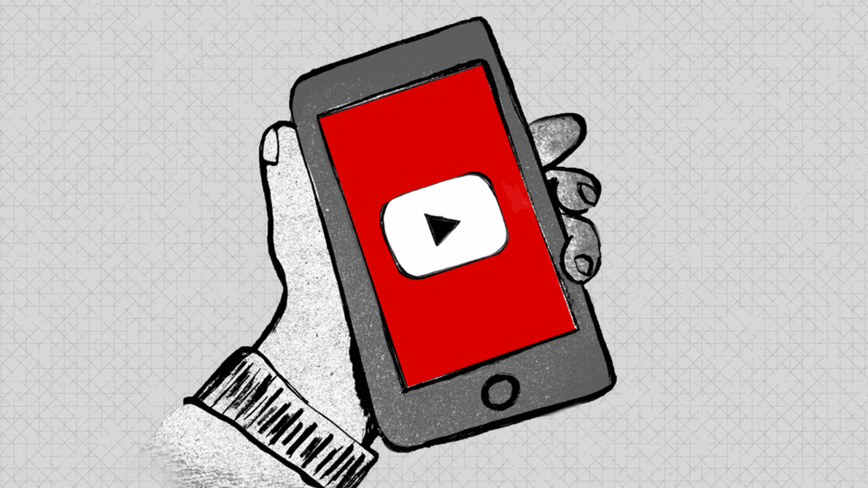
"It Matches My Worldview": Examining Perceptions and Attitudes Around Fake Videos
Farhana Shahid*
Srujana Kamath*
Annie Sidotam
Vivian Jiang
Alexa Batino
Aditya Vashistha
Notes:
Hello Everyone! I’m Farhana, a graduate student at Cornell Information Science. Today I’m really happy to be here. This one is special because not only it’s my first paper in CHI but also this is the first time I am attending any in-person conference. Today on behalf of my team, I will be presenting our latest wok "It Matches My Worldview": Examining Perceptions and Attitudes Around Fake Videos, co-authored with Srujana Kamath, Annie Sidotam, Vivian Jiang, Alexa Batino, and Aditya Vashistha.

Slide 2
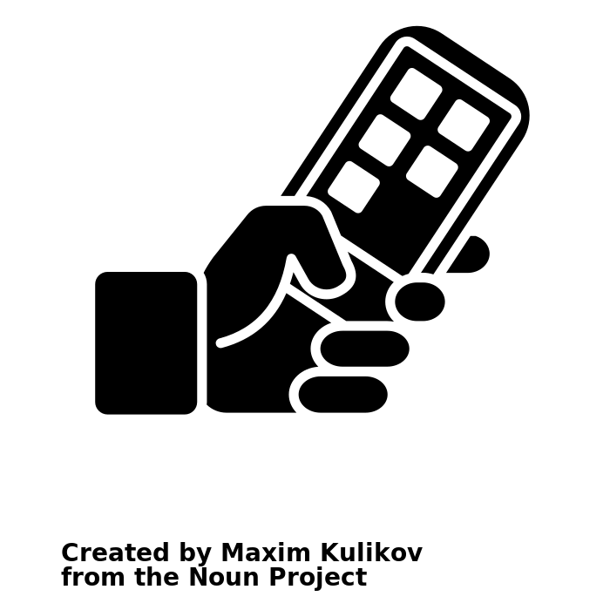

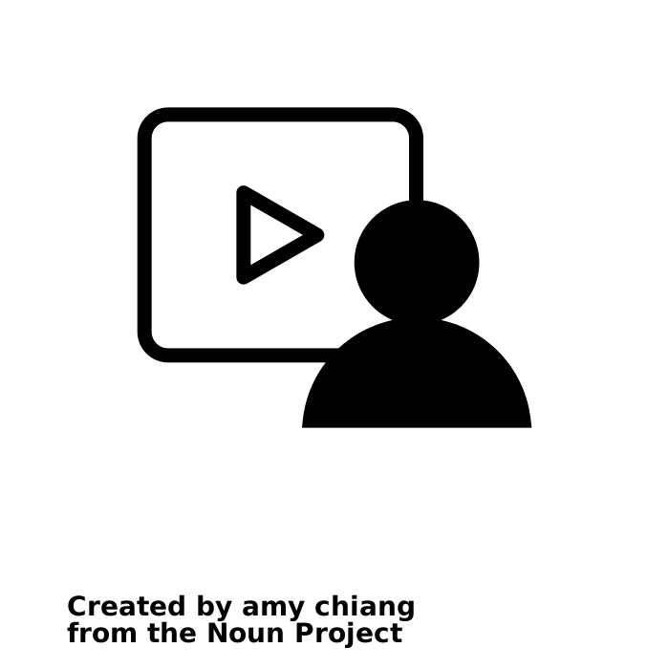



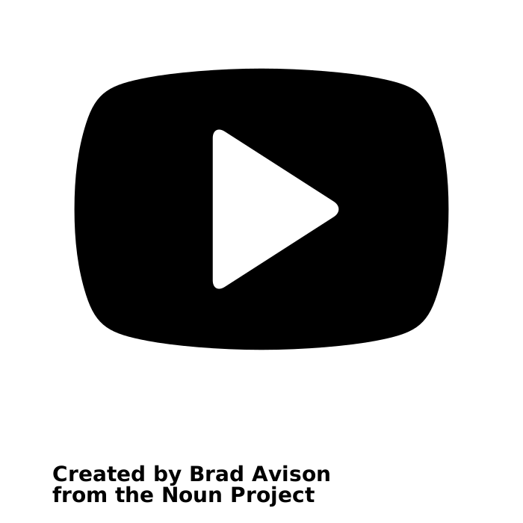
Increasing popularity of video sharing platforms
Next billion users from the Global South
Seeing is Believing
Notes:
Recently videos are becoming increasingly popular across different social media platforms for their greater capacity to engage users. In particular, low-literate users can easily engage with videos as it does not require any added skills. Thus, different video sharing platforms are rapidly growing popular among the new users emerging from the Global South. With the proliferation of fake videos on social media platforms, videos are the most used modality through which these users consume different types of content including misinformation.

Slide 3
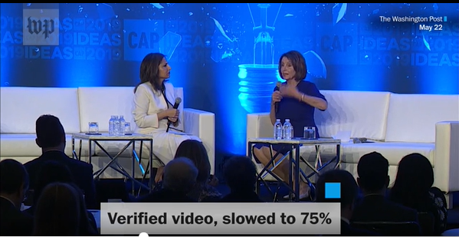
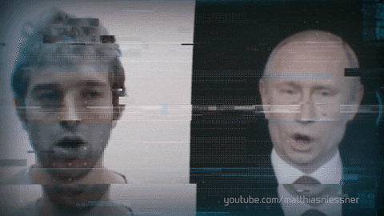
Fake Videos
Cheapfake: Video frame slowed down to make Nancy Pelosi’s speech appear slurred and drunk
Deepfake: A puppet-mastered deepfake to transfer source’s head movement and facial expressions on Putin’s face
Image credit: Washington Post, Medium
Notes:
Among different types of fake videos there are cheapfakes that can be easily generated using softwares, such as photoshop and common video editing techniques. For example, in this cheapfake, video frames were slowed down to 75% to make Nancy Pelosi’s speech sound slurred and drunk and this manipulated video was widely shared on social media.
On the other hand, there are AI-generated deepfakes that closely resemble the real videos and show people speaking or doing things that they did not do. In this puppet-masterd deepfake, source’s head movement and facial expressions were transferred to Putin’s face, which he never really did.

Slide 4


Prior Work
Research Questions
How do users from low-resource settings perceive and interact with fake videos?
Automated and human detection of deepfakes
Cues to detect deepfakes
Training to help people detect deepfakes
How do they perceive the harms of fake videos and what they consider necessary to curb its spread?
Notes:
However, most of the prior work on fake videos heavily focus on deepfakes in the Global North. For example, how machines and humans detect deepfakes, what cues they use and how to design training programs to help people better spot deepfakes.
In contrast, there is little work to understand how emerging users in the global south engage with different types of fake videos, including deepfakes. To address this critical gap, we explore two main questions in our work:
1. How do users from low-resource settings perceive and interact with fake videos?
2. How do they perceive the harms of fake videos and what they consider necessary to curb its spread?

Slide 5




Methodology
15 urban users (7 F, 8 M)
21 rural users (11 F, 10 M)
Video probes (3 deepfakes, 1 real)
Notes:
To address our research questions, we conducted semi-structured interviews with 15 urban and 21 rural social media users in India. We used video probes: 3 deepfakes and one real video to elicit spontaneous responses from our participants.

Slide 6
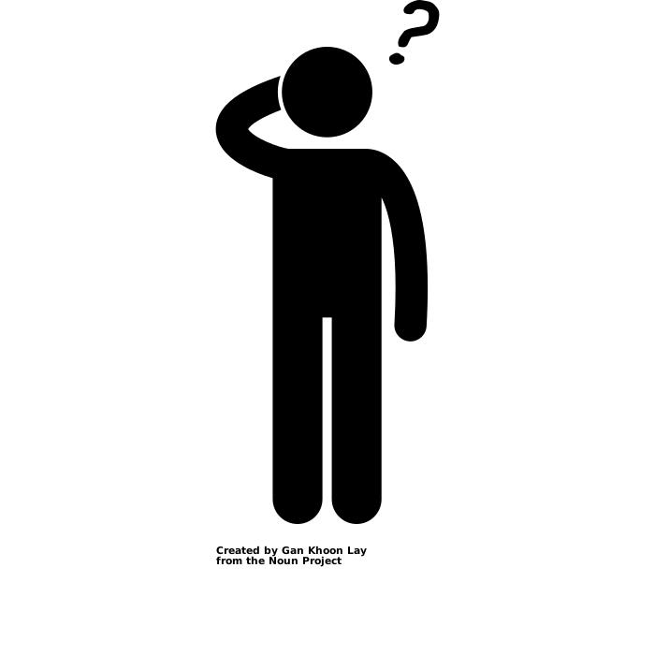
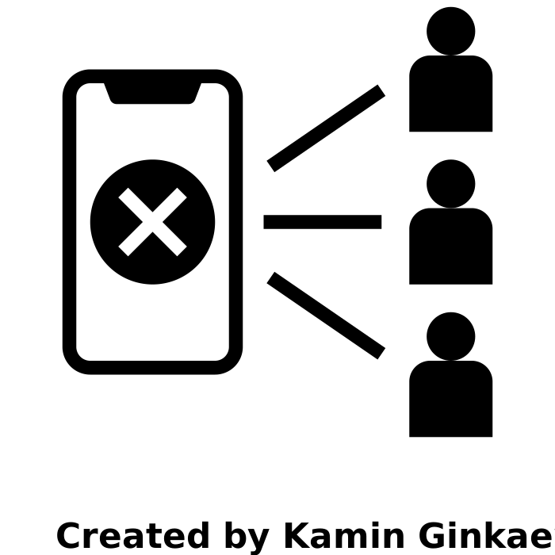
Users’ Perceptions of Fake Videos
No idea about doctored or edited videos and even deepfakes
“I never receive fake videos as I am only connected with my friends and family on social media”
Inaccurate information presented in video format is fake video
“They used protesting students’ video with misleading comment to spread propaganda. We see such videos almost everyday.”
Digitally manipulated fake videos are of poor quality and easier to spot
“I once spotted a fake video. It was easy as the speaker’s lips were not synchronizing with the audio”
Notes:
We observed that users have varying perceptions of what comprises fake videos.
For example, many users are unaware of digitally manipulated fake videos let alone deepfakes. Many people believe fake videos can only be shared by strangers and there’s no way for them to receive fake videos as they only interact with friends and family on social media.
In fact, most users perceive videos to be fake only when they present inaccurate information. Such users only considered the possibility of real video either with misleading narrative or when used out of context.
Few users who know about doctored videos expect them to be of poor quality and easily discernible. However, some rural participants even trusted obviously inferior cheapfake videos assuming the glitches or mismatched audio are caused by poor network connectivity.

Slide 7

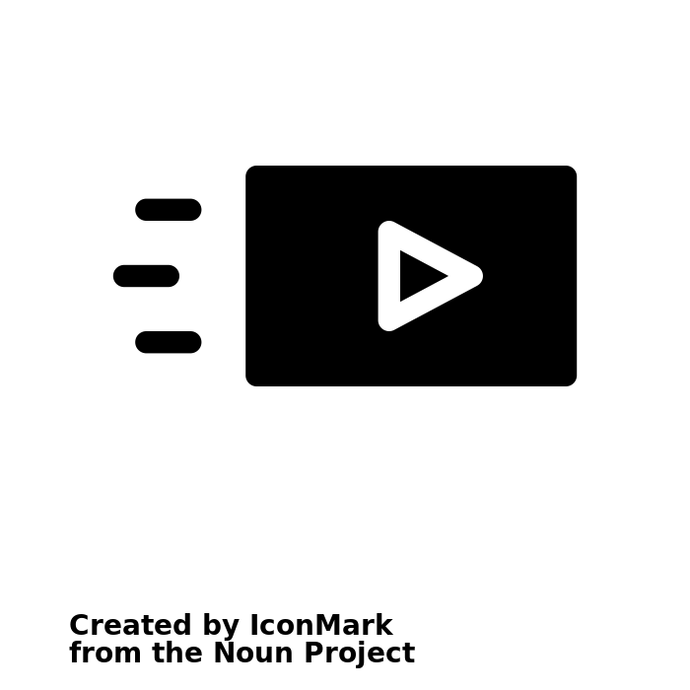
Users’ Responses to Fake Videos
Lacks willingness to either spot or report fake videos
“I think most people know the video is fake. So I just ignore it.”
Some think fake videos can cause no harm
“These funny fake videos are all means to earn money. With more subscribers you will get more likes and earn more.”
Prefers to share videos that supports their worldview even if it is fake
“If my worldview matches with a video, I will definitely share it even if it’s fake.”
Notes:
When we analyzed users’ responses, we found most users lack the skills and willingness to spot fake videos and expected other users would be aware of the fact.
some users were oblivious to the risks and harms of fake videos and considered entertaining fake videos as a mean to earn money.
Even when users know a video to be fake, they prefer to take no action and sometimes willingly share fake videos that favor their worldview.

Slide 8

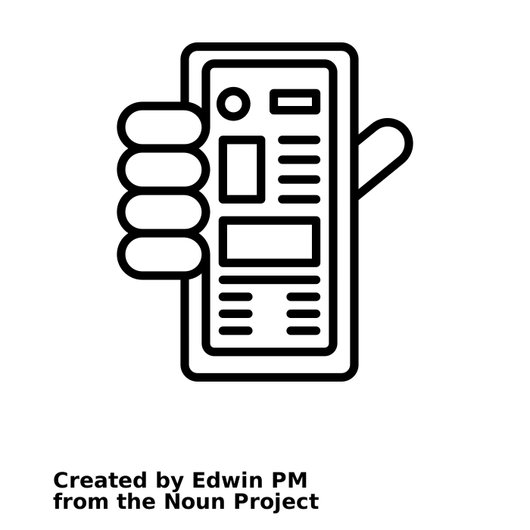


Actionable Insights to Prevent Fake Videos
Intermixing short-form videos/ infographics on fake videos with ads on news feed
Design explainable AI based credibility indicators in local dialect
Online training for voluntary fact-checkers to utilize crowd-sourced credibility assessment
Making reporting feature more visible and transparent
Notes:
Based on participants’ responses, we offer several actionable insights to curb the spread of fake videos.
For example, since many users are unaware of digitally manipulated fake videos, to raise awareness short-form videos/ infographics on fake videos could be intermixed with ads on users’ news feed.
As many users lack the skills to spot fake videos, to relieve them of the burden of identifying fake videos, automated explainable AI based credibility indicators should be designed in local languages so that low-literate users can easily understand.
However, it has been observed that people have less trust in AI based CIs and they also suffer from misidentifications of content. To address this, we can leverage crowd-sourced credibility raters by arranging online trainings for voluntary fact-checkers. Many prior studies investigated designs of training programs to help people better spot fake videos.
And finally, making reporting feature more visible and transparent as many of our participants shared they have no idea how to access this feature and how does reporting work and these make them less reluctant to report anything on social media.

Slide 9
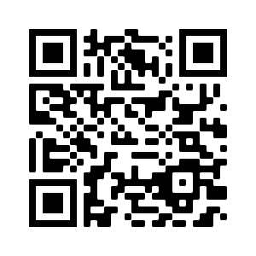


https://bit.ly/chi22-fake-video
Farhana Shahid
fs468@cornell.edu
FarhanaShahid_
Thank You!
Notes:
For more details, please check out our paper. If you have any questions please feel free to reach out to us. Thank you!

